Slide 1
Unit Conversions
Introduction to Engineering Design
© 2012 Project Lead The Way, Inc.

Slide 2
Unit Conversion
Necessary in science and engineering to work across different systems of measurement or to express quantities in different units within a single system

Slide 3



Unit Conversion
Conversion factor
  Multiplied by a quantity to convert the quantity to alternate units
  A ratio (fraction) in which the quantity in the numerator is equivalent to the quantity in the denominator
  Contains desired units in the numerator and the given units in the denominator
  The value of the conversion factor is 1
= 1
Conversion Factor
$$\frac{\text{Desired} \text{Units}}{\text{1}}$$
  $$\text{Given} \text{Units} • \frac{\text{Desired} \text{Units}}{\text{Given} \text{Units}} \text{=} \text{Desired} \text{Units}$$
$$\frac{\text{Given} \text{Units}}{\text{1}}$$
Notes:
[Read the first two bullets then click].
So when creating a conversion factor, the desired units should be placed in the numerator and the desired units in the denominator.
[click]Since the value in the numerator is equivalent to the value in the denominator, the value of the conversion factor is 1.
[click] If we rewrite the original Given Units as Given Units/1 [click], we can see that the Given Units will cancel [click], resulting in an answer in the Desired Units/1 [click]. We can then write the answer without the 1 in the denominator.[click]

Slide 4
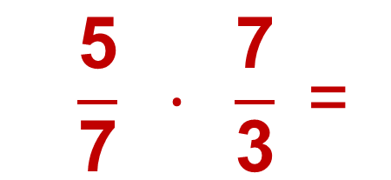
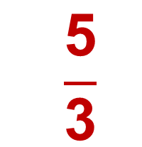
Unit Conversion
Conversion factor
  Using a conversion factor to cancel unwanted units is similar to multiplying fractions
  $$\frac{\text{5}}{\text{7}} · \frac{\text{7}}{\text{3}} \text{=}$$
  $$\frac{\text{5}}{\text{3}}$$
Notes:
Canceling unwanted units using conversion factors is similar to multiplication of fractions in which numbers that factor in both the numerator and the denominator can be canceled. [click]
For instance, in this problem, you may cancel the 7s – one in the numerator and one in the denominator – [click] to give a result of 5/3. [click]

Slide 5
Writing Numbers – SI System
Larger Smaller
Power of 10 | Prefix | Abbreviation
10¹ | deca- | da
10² | hecto- | h
10³ | kilo- | k
10⁶ | Mega- | M
10⁹ | Giga- | G
Power of 10 | Prefix | Abbreviation
10⁻¹ | deci- | d
10⁻² | centi- | c
10⁻³ | milli- | m
10⁻⁶ | micro- | µ
10⁻⁹ | nano- | n
Examples:
10 m = 1 decameter
1,000 L = kiloliters
1,000,000 g = Megagram
Examples:
.01 m = centimeter
.001 L =milliliter
.000,001 g = microgram
Notes:
The prefixes can be applied to meter, gram, and liter.
Notice that the power of 10 is reflected in the equivalencies. For instance, 10^1 is 10 [click].
10^3 is 1000 [click], and 10^6 is 1 million.
Similarly, 10^-2 is equivalent to one hundredth [click], 10^-3 is equivalent to one thousandth [click] and 10^-6 is equivalent to on millionth.
If you start with the number 1.0, the power of ten can be interpreted as moving the decimal point right (for positive exponents) or left (for negative exponents).
Remember that the gram is not technically an SI base unit, but the prefixes still apply. A kilogram is the SI base unit and is used in other unit definitions.

Slide 6
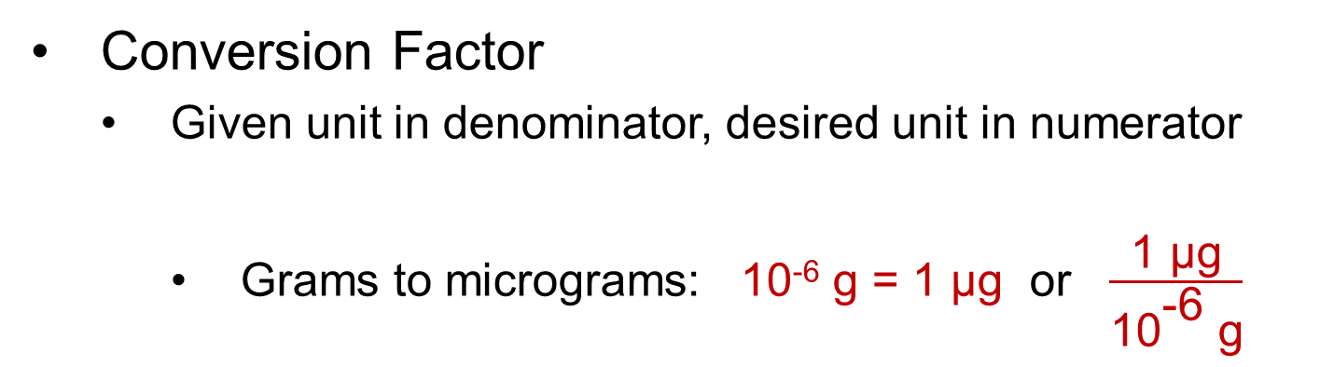
Conversion of Units – SI System
Prefixes indicate the power of 10
Power of 10 | Prefix | Abbreviation
10¹ | deca- | da
10² | hecto- | h
10³ | kilo- | k
10⁶ | Mega- | M
10⁹ | Giga- | G
Power of 10 | Prefix | Abbreviation
10⁻¹ | deci- | d
10⁻² | centi- | c
10⁻³ | milli- | m
10⁻⁶ | micro- | µ
10⁻⁹ | nano- | n
Conversion Factor
  Given unit in denominator, desired unit in numerator
    Grams to micrograms: 10⁻⁶ g = 1 µg or $\frac{\text{1 }\text{μ}\text{g}}{{\text{10}}^{\text{−6}} \text{g}}$
Desired Unit
Given Unit
Notes:
Conversion factors are based on equivalencies between units. The prefix table given on the PLTW Engineering Formula Sheet provides the equivalencies of SI units in terms of powers of 10.
So, for example, one decaliter is equivalent to 10^1 liters. [click]
One nanogram is equivalent to 10^-9 gram. [click]
Conversion factors are created by using these equivalencies in the form of a fraction equal to 1. [click]
Since 1 microgram is equivalent to 10^-6 grams, the fraction (1µg/10^-6g) is equal to one. [click]
Note: There is a memory aid that can be used with SI System prefixes. The prefixes that describe first three orders of magnitude of large quantities have harsh ‘k’ pronunciations. The prefixes that describe first three orders of magnitude of small quantities have soft pronunciations.

Slide 7
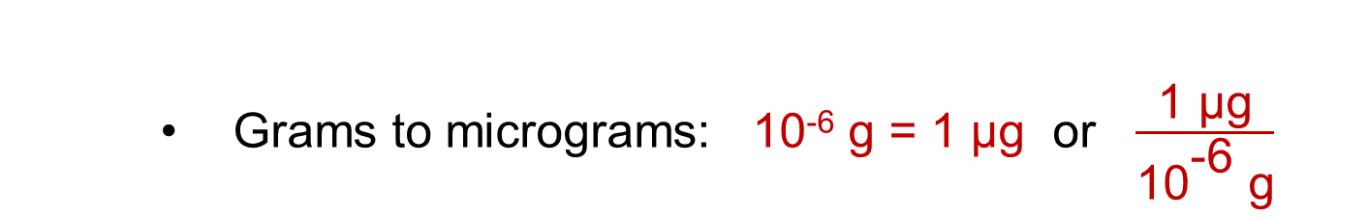
Conversion of Units – SI System
Prefixes indicate the power of 10
Power of 10 | Prefix | Abbreviation
10¹ | deca- | da
10² | hecto- | h
10³ | kilo- | k
10⁶ | Mega- | M
10⁹ | Giga- | G
Power of 10 | Prefix | Abbreviation
10⁻¹ | deci- | d
10⁻² | centi- | c
10⁻³ | milli- | m
10⁻⁶ | micro- | µ
10⁻⁹ | nano- | n
Equal to 1
Equivalency
    Grams to micrograms: 10⁻⁶ g = 1 µg or $\frac{\text{1 }\text{μ}\text{g}}{{\text{10}}^{\text{−6}} \text{g}}$
Notes:
Because Conversion factors are created by using equivalent quantities, [click] the resulting fraction is equal to 1.
Since 1 microgram is equivalent to 10^-6 grams, the fraction (1µg/10^-6g) is equal to one. [click]

Slide 8

Conversion of Units – SI System
Prefixes indicate the power of 10
Power of 10 | Prefix | Abbreviation
10¹ | deca- | da
10² | hecto- | h
10³ | kilo- | k
10⁶ | Mega- | M
10⁹ | Giga- | G
Power of 10 | Prefix | Abbreviation
10⁻¹ | deci- | d
10⁻² | centi- | c
10⁻³ | milli- | m
10⁻⁶ | micro- | µ
10⁻⁹ | nano- | n
Desired Unit
Megameters to meters: 10⁶ m = 1 Mm or
$\frac{{\text{10}}^{\text{6}} \text{m}}{\text{1 }\text{Mm}}$
Given Unit
Notes:
What is the conversion factor used to convert Megameters to meters? [Allow students to answer] [click]
As always, the desired units are in the numerator and the given units are in the denominator. [click]

Slide 9

Conversion of Units – SI System
Prefixes indicate the power of 10
Power of 10 | Prefix | Abbreviation
10¹ | deca- | da
10² | hecto- | h
10³ | kilo- | k
10⁶ | Mega- | M
10⁹ | Giga- | G
Power of 10 | Prefix | Abbreviation
10⁻¹ | deci- | d
10⁻² | centi- | c
10⁻³ | milli- | m
10⁻⁶ | micro- | µ
10⁻⁹ | nano- | n
Equal to 1
Equivalency
Megameters to meters: 10⁶ m = 1 Mm or $\frac{{\text{10}}^{\text{6}} \text{m}}{\text{1 }\text{Mm}}$
Notes:
Again, because 10^6 meters is equivalent to 1 Megameter [click], the conversion factor is equal to 1 [click] and does not change the value of the quantity once converted.

Slide 10
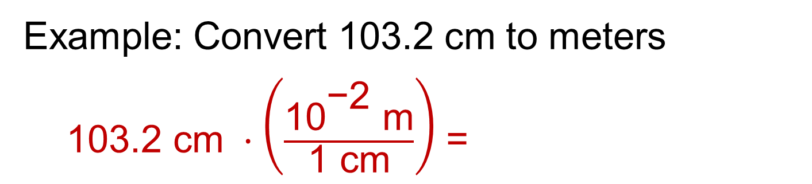
Conversion of Units – SI System
Example: Convert 103.2 cm to meters
  $\text{103.2 }\text{cm} ·\left(\frac{{\text{10}}^{\text{−2}} \text{m}}{\text{1 }\text{cm}}\right)$ =
Desired Unit
1.032 m
Given Unit
Powers of 10
Power of 10 | Prefix | Abbreviation
10⁻¹ | deci- | d
10⁻² | centi- | c
10⁻³ | milli- | m
10⁻⁶ | micro- | µ
10⁻⁹ | nano- | n
10⁻¹² | pico- | p
103.2 ∙ 10⁻² m
10.32 ∙ 10⁻¹ m
1.032 ∙ 10⁰ m
1.032 m
Notes:
To convert among SI units, simply apply a conversion factor using the appropriate power of 10 in which the desired units is in the numerator and the given units is in the denominator. [Click]
The centimeter units will cancel, leaving the result in meters. [click]
Note that [click] powers of 10 can be interpreted as the number of places to move the decimal point. In this case, the power of 10 is -2, therefore the decimal place can be moved 2 places to the left.

Slide 11

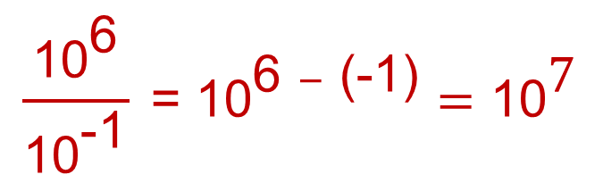
Rules of Exponents
10⁰ = 1
10^{m} ∙ 10^{n} = 10^{m+n}
10⁵ ∙ 10⁻² = 10⁵ ⁺ ⁻² = 10³
$\frac{{\text{10}}^{\text{m}}}{{\text{10}}^{\text{n}}} \text{= }{\text{10}}^{\text{m}\text{−}\text{n}}$
1.032 ∙ 10⁰ m = 1.032 m
$$\frac{{\text{10}}^{\text{6}}}{{\text{10}}^{\text{−1}}} \text{= }{\text{10}}^{\text{6 }−\text{ (−1)}}={\text{10}}^{\text{7}}$$
Notes:
These Rules of Exponents will help you manipulate the powers of ten and make conversions using metric units.

Slide 12
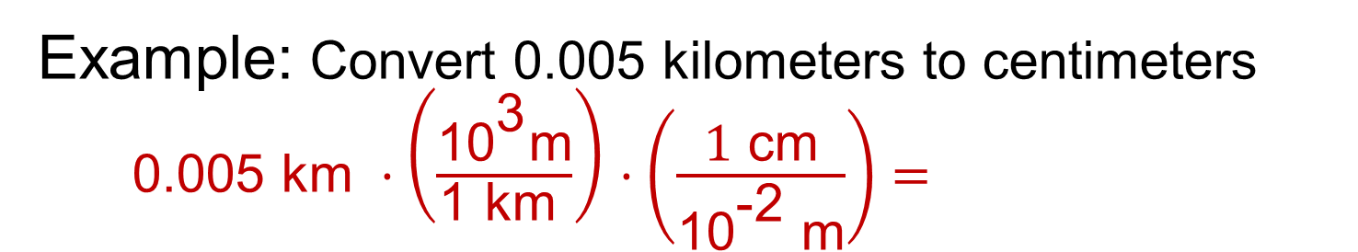
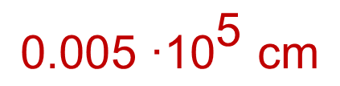
Conversion of Units – SI System
Example: Convert 0.005 kilometers to centimeters $\text{0.005 }\text{km} ·\left(\frac{{\text{10}}^{\text{3}}\text{m}}{\text{1 }\text{km} }\right)$ $·\left(\frac{\text{1} \text{cm}}{{\text{10}}^{\text{−2}} \text{m}}\right)=$
$$\text{0.005 }\text{∙}{\text{10}}^{\text{5}} \text{cm}$$
Powers of 10
0.005 ∙ 10⁵ cm
0.05 ∙ 10⁴ cm
0.5 ∙ 10³ cm
5.0 ∙ 10² cm
50. ∙ 10¹ cm
500. ∙ 10⁰ cm
500 cm
Notes:
To convert among SI units, simply apply conversion factors using the appropriate power of 10 in which the desired unit is in the numerator and the given unit is in the denominator. [2 Clicks]
The units should cancel, leaving the result in the desired units. [click]
Again, [click] powers of 10 can be interpreted as the number of places to move the decimal point. In this case the power of 10 is 5, therefore the decimal place can be moved 5 places to the right, [many clicks] giving the final result of 500 cm.

Slide 13
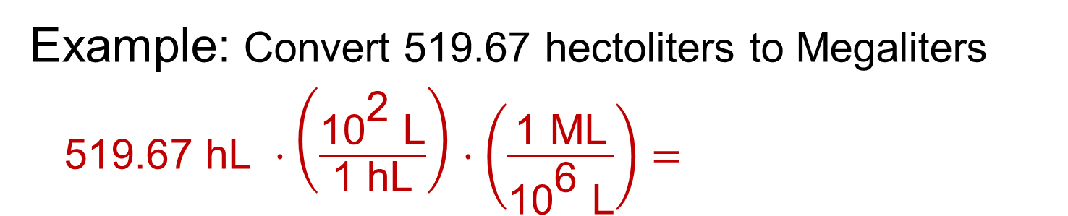
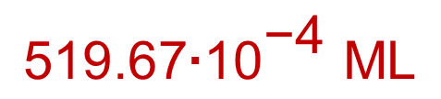
Conversion of Units – SI System
Example: Convert 519.67 hectoliters to Megaliters
$\text{ 519.67 }\text{hL} ·\left(\frac{{\text{10}}^{\text{2}} \text{L}}{\text{1 }\text{hL}}\right)$ $·\left(\frac{\text{1} \text{M}\text{L}}{{\text{10}}^{\text{6}} \text{L}}\right)=$
$$\text{519.67}\text{∙}{\text{10}}^{\text{−4}} \text{ML}$$
Powers of 10
519.67 ∙ 10⁻⁴ ML
51.967 ∙ 10⁻³ ML
5.1967 ∙ 10⁻² ML
0.51967 ∙ 10⁻¹ ML
0.051967 ∙ 10⁰ ML
0.051967 ML
Notes:
To convert among SI units, simply apply conversion factors using the appropriate power of 10 in which the desired unit is in the numerator and the given unit is in the denominator. [2 Clicks]
The units should cancel, leaving the result in the desired units. [click]
Again, [click] powers of 10 can be interpreted as the number of places to move the decimal point. In this case the power of 10 is -4, therefore the decimal place can be moved 4 places to the left, [many clicks] giving the final result of 0.051967 ML.

Slide 14
Conversion of Units
Notes on precision:
Technically, the number of significant digits should remain the same after conversion (when using exact conversion factors).
Measurements are often recorded to incorrect precision.
Alternately, converted measurements are often rounded to a given number of decimal places in lieu of considering significant digits.
  Examples: Nearest tenth of a meter or eighth of an inch
If the precision of a measurement is critical, CHECK.
Notes:
The conversion factors are often exact numbers – therefore, the number of significant figures indicating the precision of the number should not change when you convert to an alternate unit. [Click]
However, in reality, measurements, unless taken as part of a scientific investigation, are rarely recorded to the appropriate number of significant figures. [Click]
So it is not uncommon to round converted measurements to a given precision, say to the nearest hundredth of a meter or 1/8 of an inch. [Click]
If the precision of a measurement is critical, you must CHECK that the precision recorded is correct and acceptable for the application for which the measurement will be used. [Click]

Slide 15
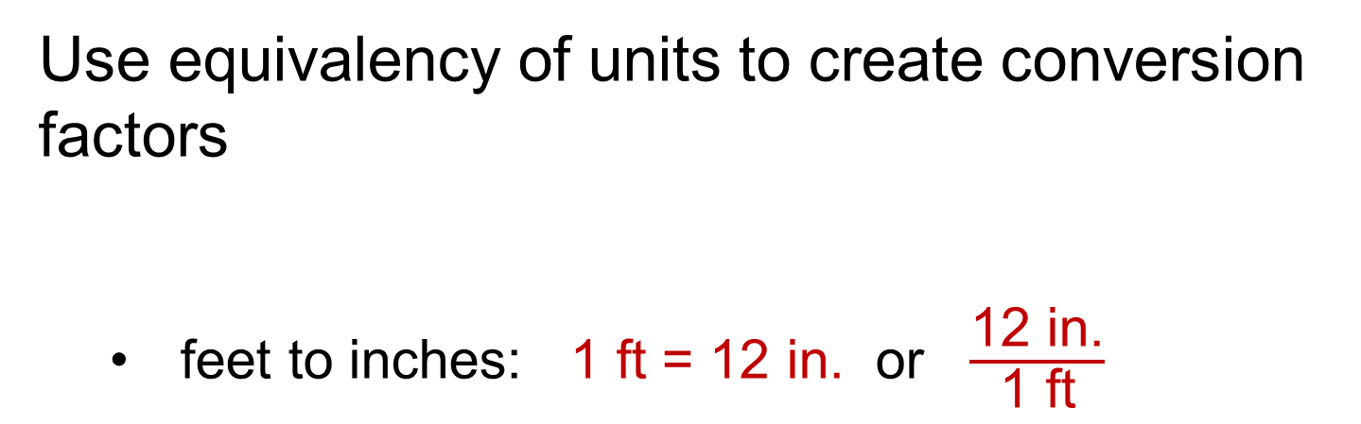

Conversion of Units – U S System
Use equivalency of units to create conversion factors
  feet to inches: 1 ft = 12 in. or $\frac{\text{12 }\text{in}\text{.}}{\text{1 }\text{ft}}$
Desired Unit
Given Unit
  miles to feet: 1 mi = 5280 ft. or
$$\frac{\text{5280 }\text{ft}}{\text{1 }\text{mi} }$$
Equal to 1
Notes:
The same concept of unit conversion applies to U S Customary Units. Conversion Factors are based on equivalencies.
Once you have identified the equivalency involving the given units and the desired units, create a ratio or fraction with the desired units in the numerator and the given units in the denominator. [click]
What is the conversion factor used to convert miles to feet? [allow students to answer] [click]
Again, because the numerator is equivalent to the denominator, the value of all conversion factors is 1. [click]

Slide 16

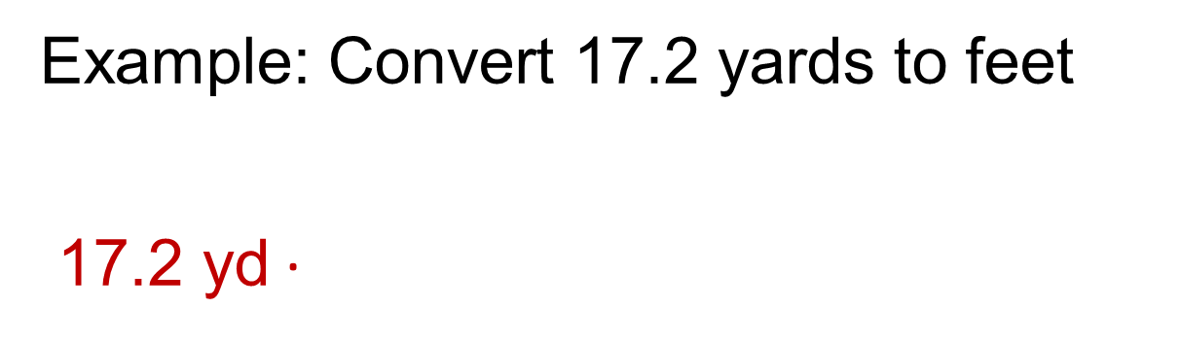
Conversion of Units – U S System
Example: Convert 17.2 yards to feet
$\text{17.2 }\text{yd}$ ·
$$\left(\frac{\text{3 }\text{ft}}{\text{1 }\text{yd}}\right)$$
= 51.6 ft
1 yd = 3 ft
Note: Technically, the number of significant digits should remain the same after conversion.
Notes:
To convert among U S Customary units, simply apply a conversion factor using appropriate equivalency in which the desired unit is in the numerator and the given unit is in denominator. What is the appropriate conversion factor to convert yards to feet? [allow students to answer] [click]
The yards cancel and you are left with feet. [click]
Assume that the conversion factors are exact numbers – therefore, the number of significant digits indicating the precision of the number should not change when you convert to an alternate unit. [Click]

Slide 17
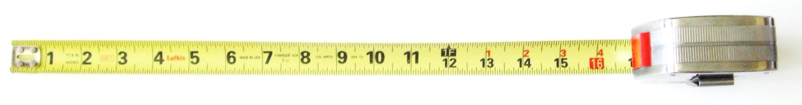

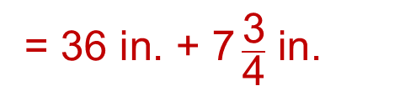
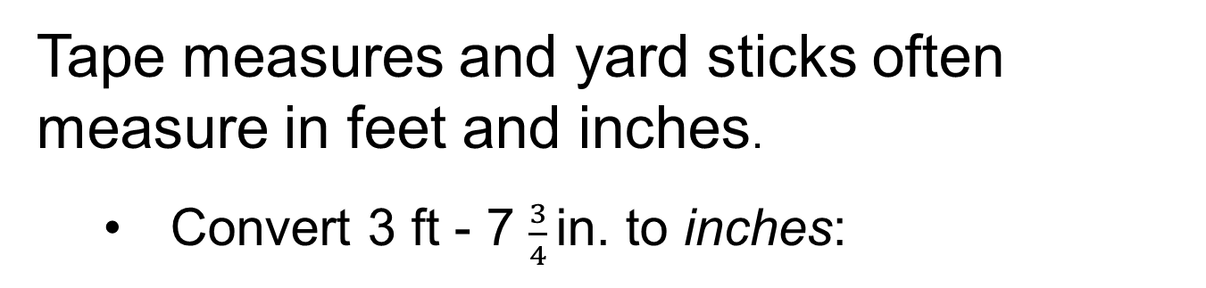
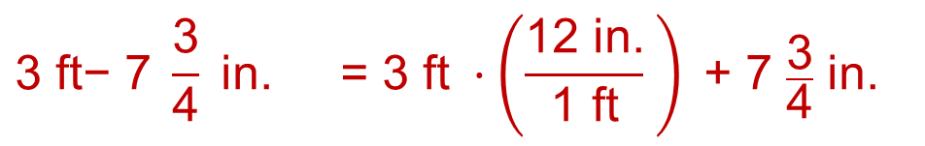
More Unit Conversions
Feet and Inches
Tape measures and yard sticks often measure in feet and inches.
  Convert 3 ft - 7 $\frac{3}{4}$in. to inches:
$$\text{3 }\text{ft}\text{− 7 }\frac{\text{3}}{\text{4}} \text{in}\text{. = 3 }\text{ft} ·\left(\frac{\text{12 }\text{in}\text{.}}{\text{1 }\text{ft}} \right)\text{ + }\text{7 }\frac{\text{3}}{\text{4}} \text{in}\text{. }$$
$$\text{ = 36 }\text{in}\text{. + 7} \frac{\text{3}}{\text{4}} \text{in}\text{. }$$
        $$\text{=} \text{43 }\frac{\text{3}}{\text{4}} \text{in}\text{. }$$
Notes:
When converting from feet and inches to inches, you must convert the portion of the measurement reported in feet to inches. [click]
Now both quantities are expressed in the same units [click]. You may add them. [click]

Slide 18

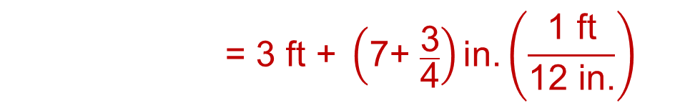
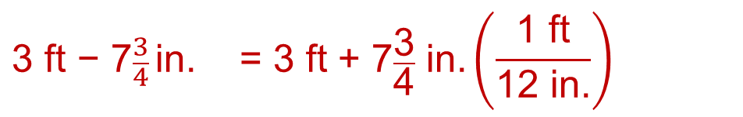
More Unit Conversions
Feet and Inches
  Convert 3 ft – 7 $\frac{3}{4}$ in. to decimal feet:
$$\text{3 }\text{ft}\text{ − 7}\frac{3}{4} \text{in}\text{. = 3 }\text{ft}\text{ + 7}\frac{\text{3}}{\text{4}} \text{in}\text{.}\left(\frac{\text{1 }\text{ft}}{\text{12 }\text{in}\text{.}}\right)$$
        $$\text{= 3 }\text{ft}\text{ + }\left(\text{7+ }\frac{\text{3}}{\text{4}}\right)\text{in}\text{.}\left(\frac{\text{1 }\text{ft}}{\text{12 }\text{in}\text{.}}\right)$$
        $$\text{= 3 }\text{ft}\text{ + 0.65 }\text{ft}$$
        = 3.65 ft
Notes:
When converting feet and inches to feet, you must first convert the inch portion of the measurement to feet. [click]
Notice that you can find the decimal equivalent of 7 ¾ by adding 7 and 3 divided by 4. [click]
Once both quantities are in the same units, you may add them to get the final result in feet. [click]

Slide 19
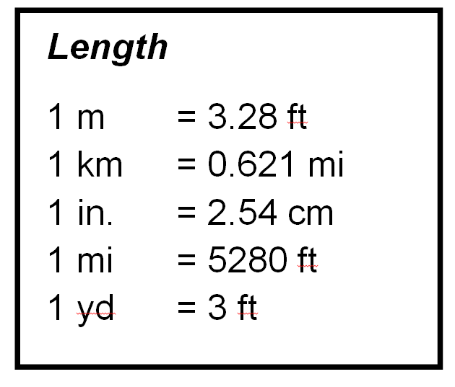

Unit Conversions
Between U S and SI Systems
Use equivalency of units to create conversion factors
Inches to centimeters:
Desired Unit
$$\frac{\text{2.54 }\text{cm}}{\text{1 }\text{in}\text{. }}$$
Given Unit
Equal to 1
Notes:
The same concept of unit conversion applies when converting between the US and the SI systems. Use equivalencies to create conversion factors with the appropriate numerator and denominator. Some of the common equivalencies between the U S and SI systems are provided on the PLTW formula sheet. [click]
What is the conversion factor for changing inches to centimeters? [Allow students to answer, then click] The desired unit is placed in the numerator and the given unit is placed in the denominator.
Again, because the numerator is equivalent to the denominator, the value of the conversion factor is 1. [click]

Slide 20
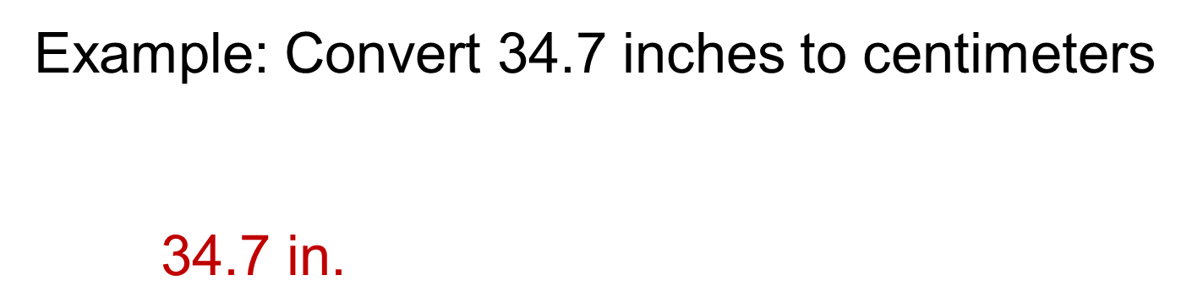

Conversion of Units Between Systems
Example: Convert 34.7 inches to centimeters
    $\text{34.7 }\text{in}\text{.}$
$$\text{.} \left(\frac{\text{2.54 }\text{cm}}{\text{1 }\text{in}\text{.}}\right)$$
= 88.1 cm
Notes:
Start with the given quantity. Then determine the appropriate conversion factor. [click] Cancel the given units which are repeated in the numerator and denominator. [click]
Perform the multiplication to obtain the result. [click]
Note that the number of significant digits in the original measurement was three. Therefore, the number of significant digits reported in the result is also three.

Slide 21
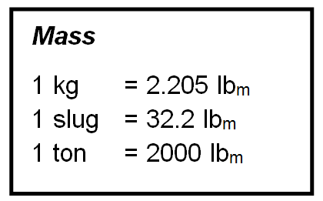
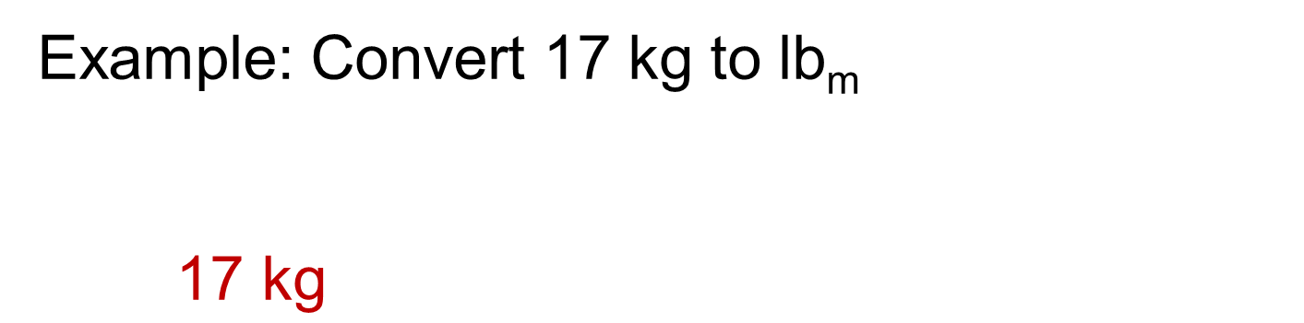

Conversion of Units Between Systems
Example: Convert 17 kg to lb_{m}
    $\text{17 }\text{kg}$
$$\text{.} \left(\frac{\text{2.205 }{\text{lb}}_{\text{m}}}{\text{1 }\text{kg}}\right)$$
= 37.48 lb_{m}
= 37 lb_{m}
Note: The number of significant digits is ambiguous in the given quantity – assume two significant digits.
Notes:
Begin with the given quantity and find an equivalency (or a series of equivalencies) that relates the given units to the desired units. [click]
Write a conversion factor so that the given units cancel and the desired units remain. [click]
Calculate the result and consider the number of significant digits. In this case the original quantity has two significant figures (we assume, although it is somewhat ambiguous since there is no decimal point). [click] So we will round the final answer to two significant digits [click] which seems reasonable.
Note that in order to be unambiguous about the number of significant digits, the original quantity could have been written with a decimal point and no zeros after the decimal point. So (17.) would definitively indicate two significant digits. Unfortunately, you will rarely see this outside of the scientific community which means the number of significant digits is often in question.
For IED, the required precision of an answer may be directly stated. If not, use a reasonable precision based on the provided information and the use of the result.

Slide 22


Unit Conversion
Dimensional Analysis
  Sequential application of conversion factors
  Units that appear in both numerator and denominator cancel
  $$\text{Given} \text{Units} • \frac{\text{Linking} \text{Units}}{\text{Given} \text{Units}} • \frac{\text{Desired} \text{Units}}{\text{Linking} \text{Units} }\text{=} \text{Desired} \text{Units}$$
$$\frac{\text{Given} \text{Units}}{\text{1}}$$
$$\frac{\text{Desired} \text{Units}}{\text{1}}$$
Notes:
If you do not have an equivalency between the given units and the desired units, you may use a series of conversion factors based on available equivalencies using linking units. [click]
By strategically selecting the linking units, you can create conversion factors that allow you to cancel the given units [click] and the linking units [click] so that the result is in the desired units. [click]

Slide 23
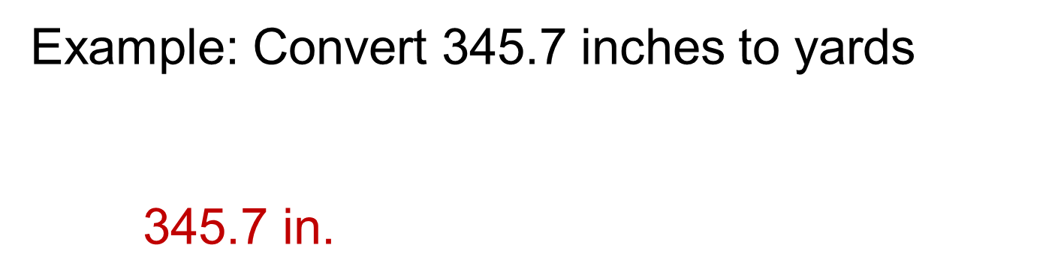


Dimensional Analysis
Example: Convert 345.7 inches to yards
    $\text{345.7 }\text{in}\text{.}$
$$\text{.} \left(\frac{\text{1 }\text{ft}}{\text{12 }\text{in}\text{.}}\right)$$
$$\text{.} \left(\frac{\text{1 }\text{yd}}{\text{3 }\text{ft}}\right)$$
= 9.602 yd
Note: The number of significant digits should remain the same after conversion. However, if the precision of the original measurement is in question, you may choose to round to a reasonable precision.
Notes:
Start with the given quantity. To convert from inches to yards, use two conversion factors. One conversion factor will convert inches to feet. [click] the second conversion factor will convert feet to yards. [click]
Then perform the calculation. The result is in yards.

Slide 24



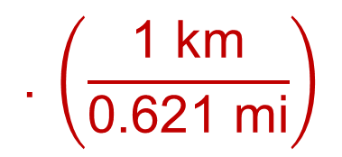
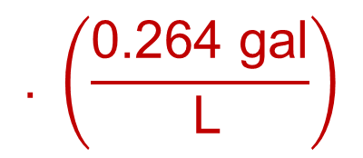
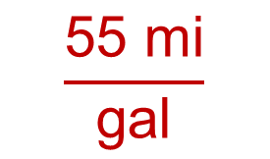
Dimensional Analysis
Example: An American car company has designed a new high fuel efficiency vehicle that is rated at 55 miles per gallon. The company plans to export the car to Europe and must advertise the fuel efficiency in SI units. What is the fuel usage rate in kilometers per liter?
$$\text{1 }\text{L}\text{ = 0.264 }\text{gal}$$
$$=\frac{\text{? }\text{km}}{\text{L}}$$
$$\frac{\text{55 }\text{mi}}{\text{gal}}$$
$$\text{.} \left(\frac{\text{0.264} \text{gal}}{ \text{L}}\right)$$
$$\text{.} \left(\frac{\text{1 }\text{km}}{\text{0.621} \text{mi}}\right)$$
$$\text{1 }\text{km}\text{ = 0.621 }\text{mi}$$
Notes:
First, identify the information that you are given [click]. In this example you are given the fuel rating of 45 mi/gal. [click]
Then identify the units in which the result should be reported [click]. In this case the results should be in km/L.
Now decide what conversion factors are needed to convert the given information into the desired result. In this case, since gallons and liters are both volume measures, we can convert between the two. An equation that represents the equivalency of gallons and liters is 1 L = 0.0264 gal. [click]
Since the gallons unit is in the denominator of the given quantity and we want gallons to cancel, we will place gallons in the numerator of the conversion factor. [click] Gallons will cancel and leave liters in the denominator, which is what we need in the result.
Next, since kilometers and miles are both length measures, we need to convert the given miles to the desired kilometers. An equation that expresses the equivalency between miles and kilometers is I km = 0.621 mi. [click]
Since miles is in the numerator in the given quantity and we want it to cancel, we will place miles in the denominator of the conversion factor. [click] Since we now have miles in a denominator and a numerator, we can cancel the mile units. [click]

Slide 25
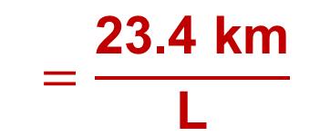
Dimensional Analysis
Example: An American car company has designed a new high fuel efficiency vehicle that is rated at 55 miles per gallon. The company plans to export the car to Europe and must advertise the fuel efficiency in SI units. What is the fuel usage rate in kilometers per liter?
$$\text{1 }\text{L}\text{ = 0.264 }\text{gal}$$
$$\frac{\text{55 }\text{mi}}{\text{gal}}$$
$$\text{.} \left(\frac{\text{0.264} \text{gal}}{ \text{L}}\right)$$
$$\text{.} \left(\frac{\text{1 }\text{km}}{\text{0.621} \text{mi}}\right)$$
$$=\frac{\text{23.4 }\text{km}}{\text{L}}$$
$$\text{1 }\text{km}\text{ = 0.621 }\text{mi}$$
Notes:
When we perform the multiplication and division, we end up with 23.4 km/L. [click]
Again, the number of significant digits in the given quantity is ambiguous since there is no decimal point. However, assuming two significant digits (which is a reasonable precision), there should be two significant digits in the result. And reporting the result in whole km/L is reasonable and probably the best level of precision for the purpose of the result, to advertise the fuel efficiency of the vehicle. [click]

Slide 26
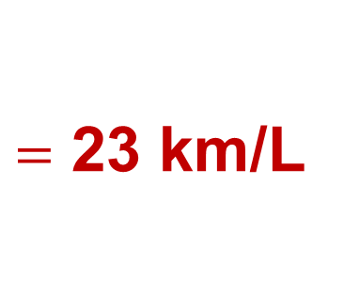
Dimensional Analysis
Example: An American car company has designed a new high fuel efficiency vehicle that is rated at 55 miles per gallon. The company plans to export the car to Europe and must advertise the fuel efficiency in SI units. What is the fuel usage rate in kilometers per liter?
$$\text{1 }\text{L}\text{ = 0.264 }\text{gal}$$
$=$ 23 km/L
$$\frac{\text{55 }\text{mi}}{\text{gal}}$$
$$\text{.} \left(\frac{\text{0.264} \text{gal}}{ \text{L}}\right)$$
$$\text{.} \left(\frac{\text{1 }\text{km}}{\text{0.621} \text{mi}}\right)$$
$$\text{1 }\text{km}\text{ = 0.621 }\text{mi}$$
Notes:
When we perform the multiplication and division, we end up with 23.4 km/L. [click]
Again, the number of significant digits in the given quantity is ambiguous since there is no decimal point. However, assuming two significant digits (which is a reasonable precision), there should be two significant digits in the result. And reporting the result in whole km/L is reasonable and probably the best level of precision for the purpose of the result, to advertise the fuel efficiency of the vehicle. [click]

