Slide 1
Elements and Principles
of Design
Introduction to Engineering Design
© 2012 Project Lead The Way, Inc.

Slide 2
Visual Design Elements
Eight integral components used in the creation of a design:
Point
Line
Color
Value
Shape
Form
Space
Texture

Slide 3
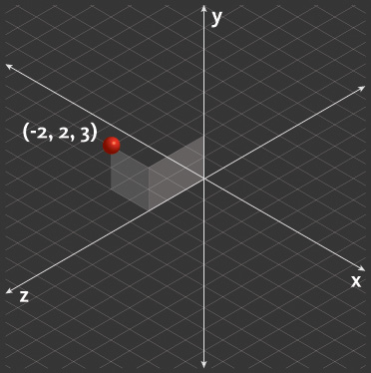
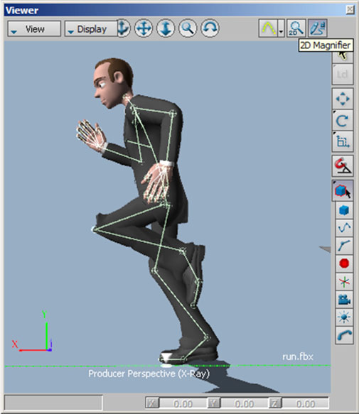
Point
Most basic element of design
Has position but no dimension
Can be described by coordinates on a plane
Used to indicate a location
Image courtesy Autodesk, Inc.
Image courtesy Autodesk, Inc.
Notes:
In this example, points are used to represent the joints between bones of a poseable 3D character. This joint representation is part of an animation rig that an animator uses to manipulate and animate the much more complicated character model.

Slide 4
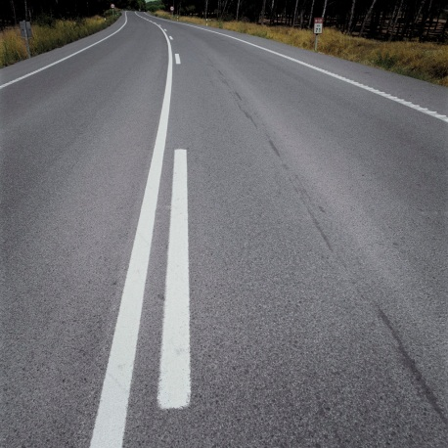
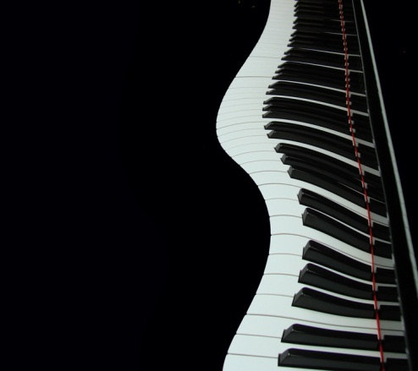
Line
Has only a length dimension
Can be used to
Define a boundary
Indicate volume
Create perspective and depth
Create textures and patterns
Suggest movement
Imply emotion
Image courtesy Autodesk, Inc.
Image courtesy Autodesk, Inc.
Microsoft Office clipart
Microsoft Office clipart
Notes:
How are lines used in these images?
To define boundaries (top)
To create a pattern or texture (star)
To create perspective (road with lines receding into distance)
To suggest movement (wavy piano keyboard)

Slide 5
Line
Types
Vertical - Represents dignity, formality, stability, and strength
Horizontal - Represents calm, peace, and relaxation
Diagonal - Represents action, activity, excitement, and movement
Curved - Represents freedom, the natural, having the appearance of softness, and creates a soothing feeling or mood

Slide 6
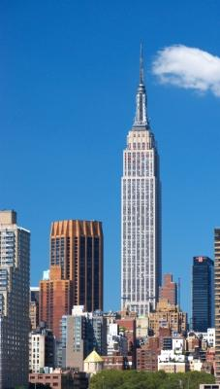
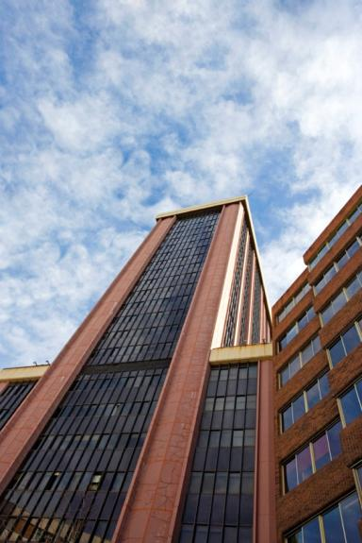
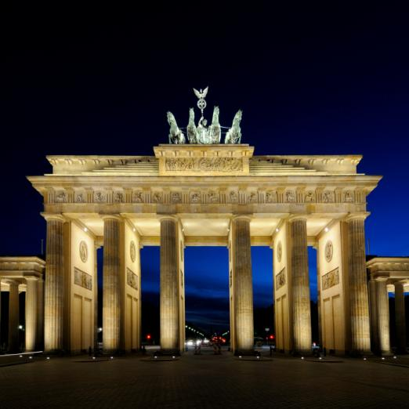
Vertical Lines
Vertical lines characterize dignity, formality, stability, and strength
The Empire State Building
Architect: Shreve, Lamb, and Harmon
Microsoft Office clipart
Skyscraper
Madrid, Spain
Brandenburg Gate
Berlin

Slide 7
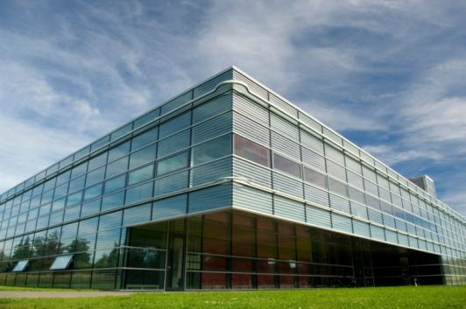
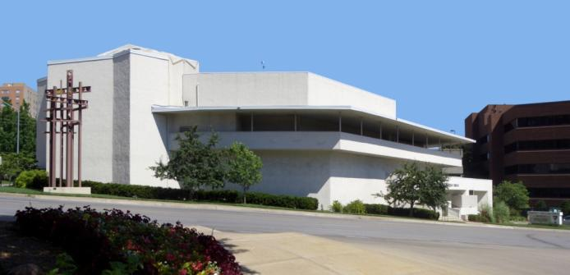
Horizontal Lines
Horizontal lines represent calm, peace, and relaxation
Microsoft Office clipart
Wikimedia.org
Community Christian Church
Kansas City, MO
Architect: Frank Lloyd Wright, 1940
Notes:
Frank Lloyd Wright was well know for using horizontal lines in many of his designs.

Slide 8
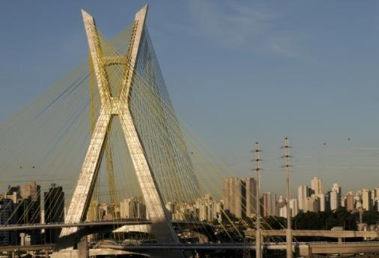
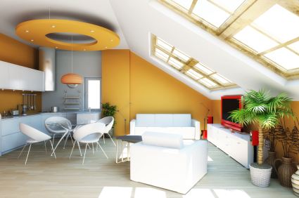
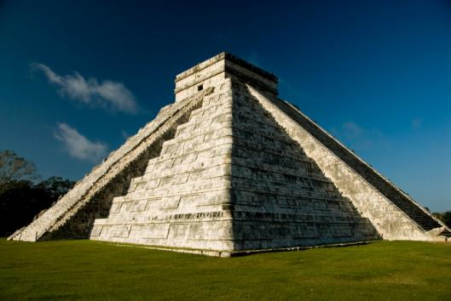
Diagonal Lines
Microsoft Office clipart
Diagonal lines give the sense of movement, action, and activity.
©iStockphoto.com
Microsoft Office clipart
Notes:
The upper right image shows the Octavio Frias de Oliverira Bridge in Sao Paulo, Brazil. This is a cable-stayed suspension bridge which opened in May 2008. It is the only bridge in the world that has two curved approaches supported by a single concrete mast.

Slide 9
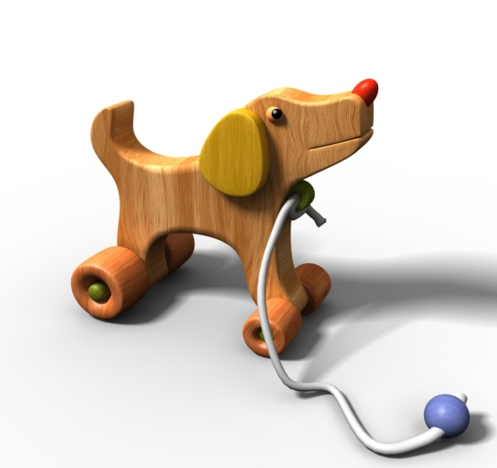
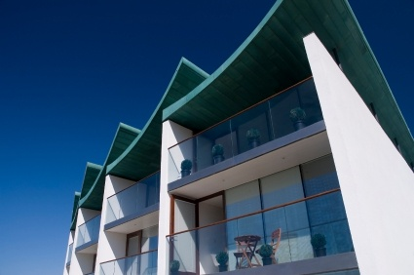
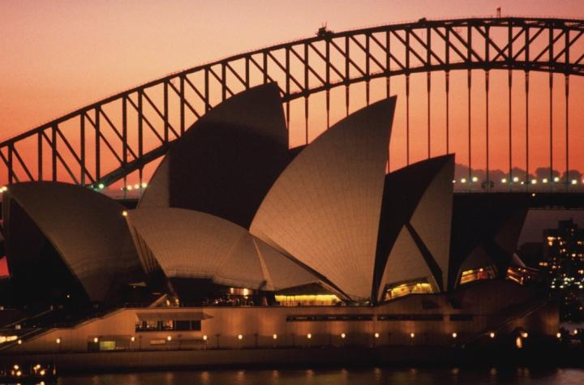
Curved Lines
Microsoft Office clipart
©iStockphoto.com
©iStockphoto.com
Microsoft Office clipart
Curved lines give the sense of freedom and a soothing mood
Sydney Opera House
Jorn Utzon
Notes:
Flowing, curved lines are used in the roof of this apartment building, the roof structure of the Sydney Opera House, the Sydney Harbor Bridge in the background, and the dog-shaped pull toy.
The Sydney Opera House is a world-famous work of architecture. The Danish architect Jorn Utzon won an international competition to design the structure. After extensive testing, Utzon decided to use a design based on sections of a sphere.

Slide 10
Color
Described by a number of qualities
Hue: base color (e.g., red)
Value: lightness or darkness
Saturation: purity or intensity relative to gray

Slide 11
Color Temperature
Image courtesy Autodesk, Inc.
Cool Colors
Blues, purples, greens
Warm Colors
Reds, oranges, yellows

Slide 12
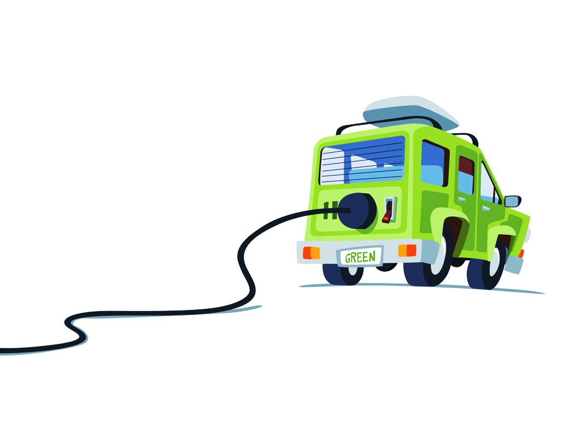
Color
Color has an immediate and profound effect on a design
Microsoft Office clipart
Microsoft Office clipart
Notes:
Many colors can have a cultural, historical, or popular connotation. Green, for example, is associated with plants and nature and often implies environmental and ecological awareness.
Designers can use these color associations to their advantage and use colors to provoke desired thoughts and emotions.

Slide 13
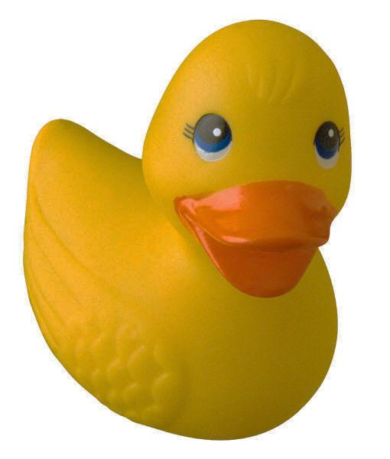
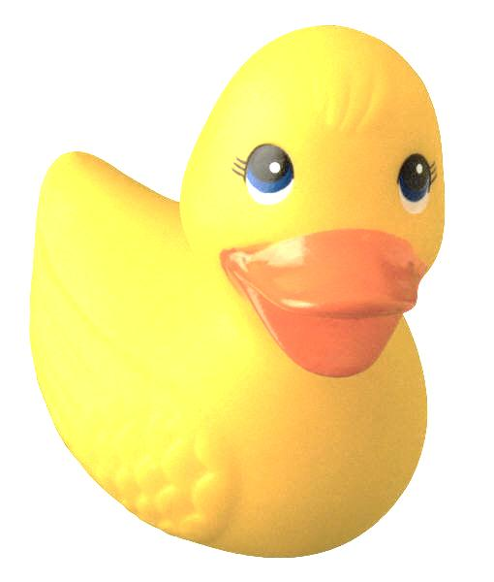
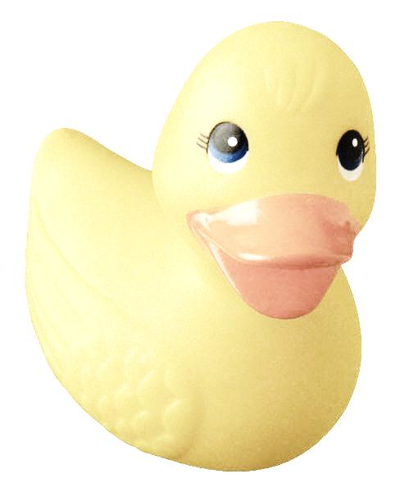
Value
Relative lightness or darkness of a color, object, or shape
Microsoft Office clipart

Slide 14
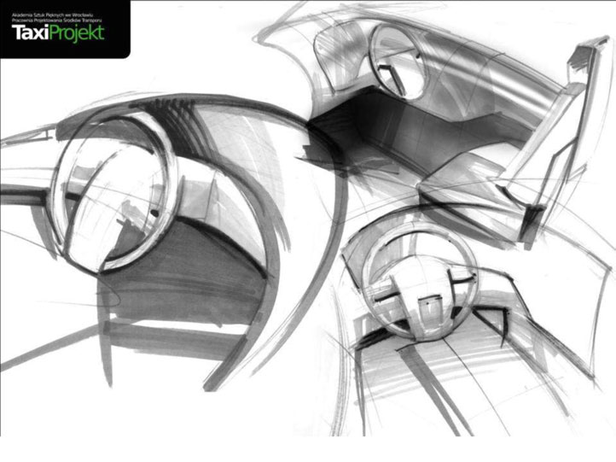
Value
Allows us to perceive shapes and the illusion of 3D objects on a 2D surface
Image courtesy Autodesk, Inc.
Notes:
In this example, an artist has created a concept sketch of the interior of a vehicle. Shading provides the gradations of value that produce a 3D effect on a flat piece of paper.

Slide 15
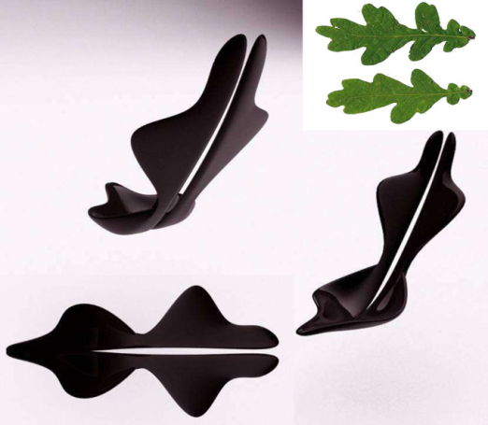
Shape
A 2D area enclosed by lines or curves
Types
Geometric: square, circle, triangle
Mechanical: simple shapes made of straight and curved lines
Organic: natural or simulating nature
Image courtesy Autodesk, Inc.
Microsoft clipart
Image courtesy Autodesk, Inc.
Geometric
Mechanical
Organic

Slide 16
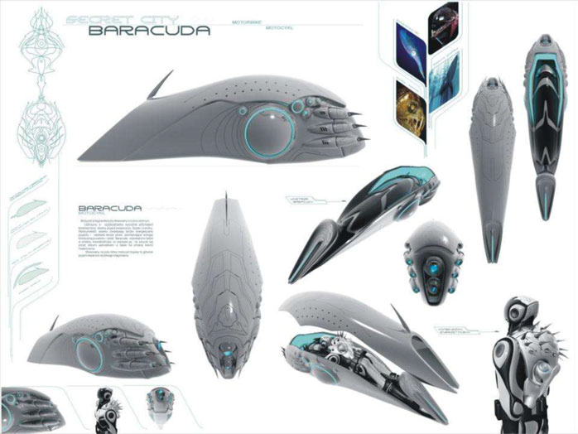
Shape
Notes:
Organic shapes are frequently used in consumer products. The most efficient shapes for performing specific tasks can often be found in nature.

Slide 17
Form
A 3D volume or solid
Often implied on a 2D surface by careful use of value
Image courtesy Autodesk, Inc.

Slide 18
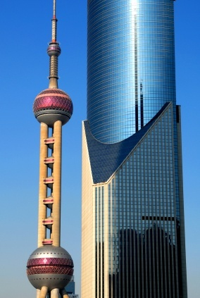
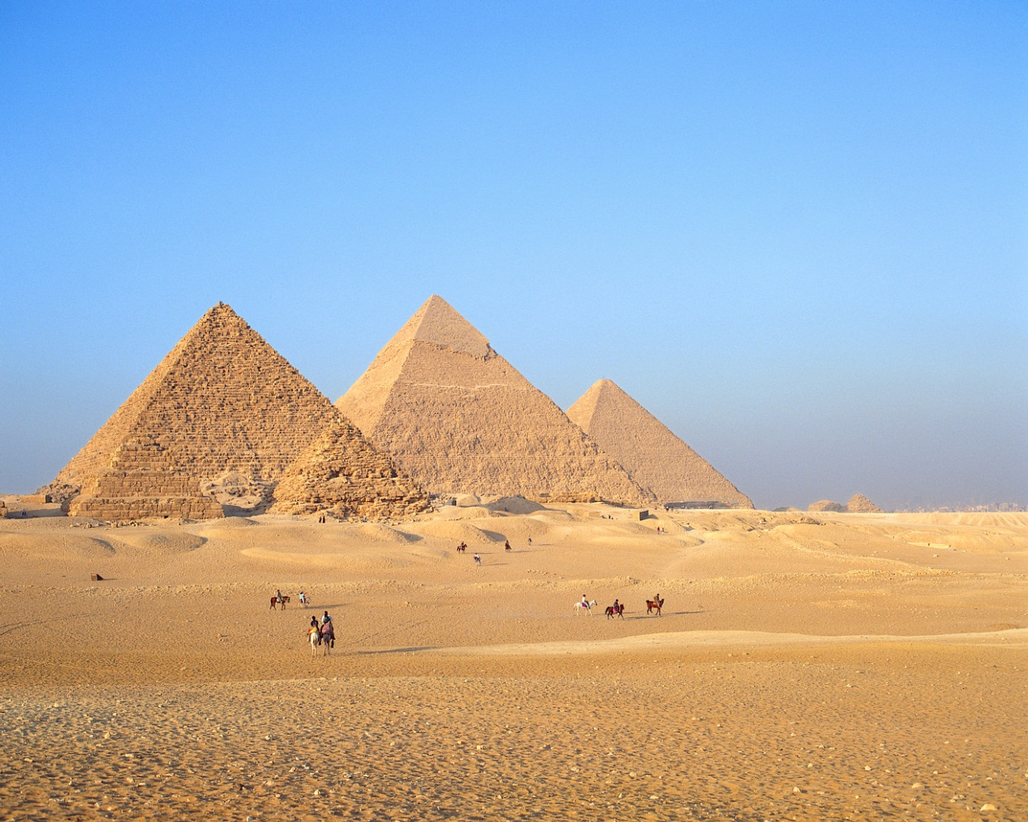
Form
©iStockphoto.com
Microsoft clipart
Oriental Pearl Tower Shanghai
Architect: Jiang Huan Cheng, Shanghai Modern Architectural Design, Co.
Ancient Egyptian Pyramids
Notes:
The Oriental Tower is a television tower in Shanghai and includes fifteen observatory levels and a revolving restaurant. Its design includes 11 spheres, large and small. The two largest spheres (shown) have diameters of 164 ft (the lower sphere) and 148 ft (the upper sphere). The design is based on the Tang Dynasty poem Pipa Song by Bai Juyi about the wonderful sprinkling sound produced by a pipa instrument, like pearls, big and small, falling on a jade plate.
The pyramids have a distinctive pyramid form. Note that the 2D image gives the impression of 3D objects due to the different values on adjacent surfaces of the pyramids.

Slide 19
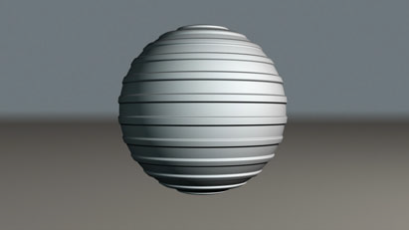
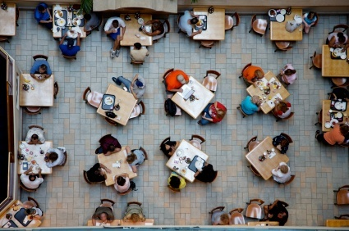
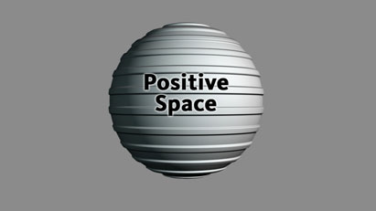
Space
Areas between and around parts of an image or the implied depth in that image
Types
Positive
Negative
©iStockphoto.com
Image courtesy Autodesk, Inc.
Notes:
What would you consider to be the positive space/negative space in the aerial image of the diners?

Slide 20
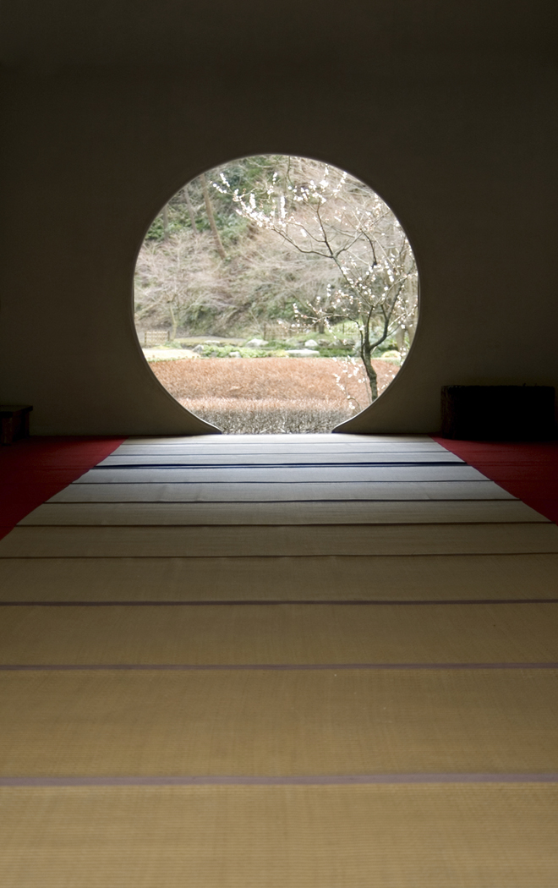
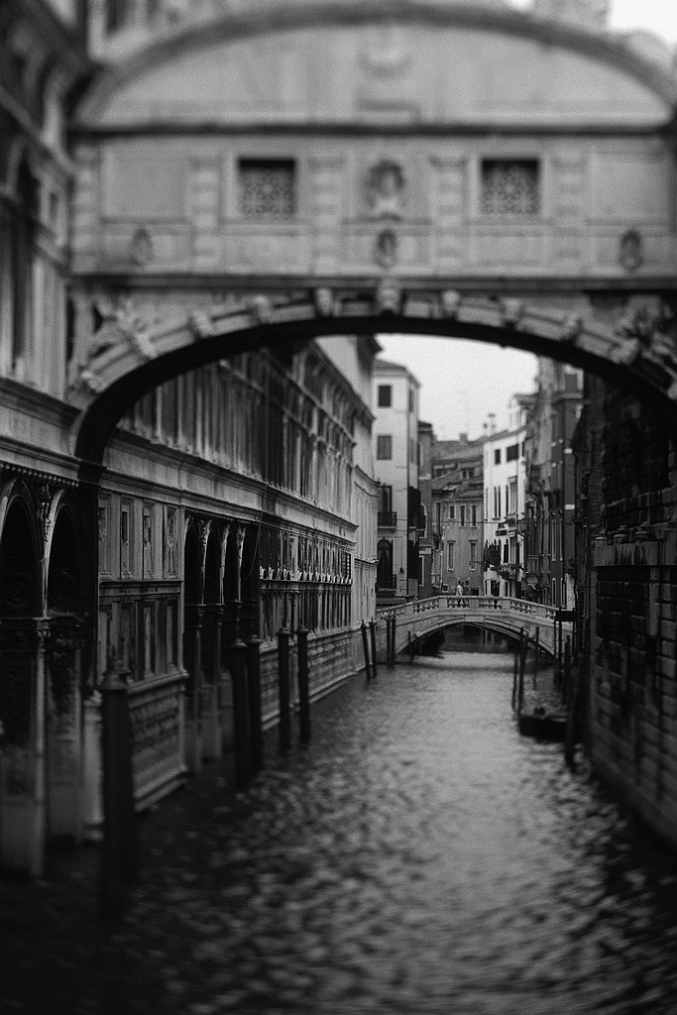
Space
Evident in images with depth
Types
Open, uncluttered
Cramped, busy
Microsoft clipart
Notes:
Architectural elements are often helpful in identifying the different levels of space.
Note the progression from foreground through middle ground to background in this image on the right taken in Venice. The space appears somewhat cramped and constricting.[click]
In contrast, this image gives the feeling of an open, uncluttered space. The perception of depth is caused by the one point perspective view. Note that the depth lines recede toward a single point and adjacent horizontal lines between the flooring panels become closer together as they get further away.
By incorporating the use of space in your design, you can enlarge or reduce the visual space.

Slide 21
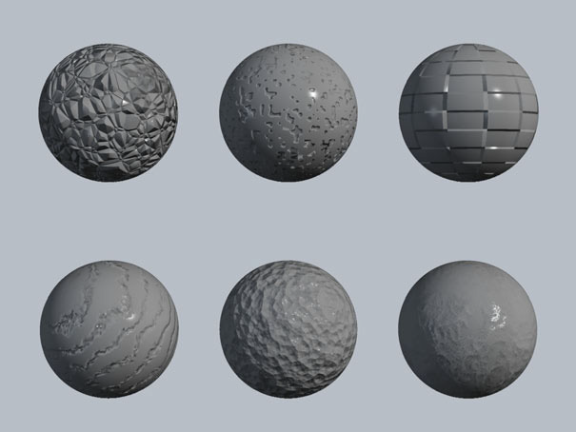
Texture
The surface look or feel
Types
Smooth
Reflects more light
More intense color
Rough
Absorbs more light
Appears darker
Image courtesy Autodesk, Inc.

Slide 22
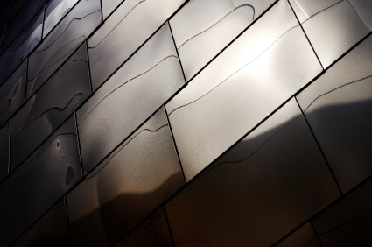
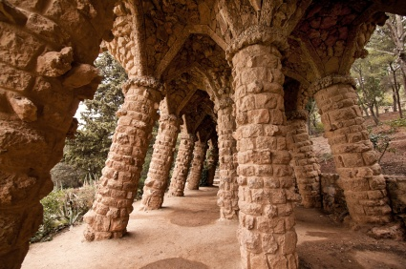
Texture
Fluffy
Smooth
©iStockphoto.com
Rough
Microsoft clipart
Exterior metal façade of Disney Concert Hall
Los Angeles
©iStockphoto.com
Park Guell – Barcelona, Spain Architect: Antonio Gaudí

Slide 23
Principles of Design
Many principles add to an interesting design
Balance
Emphasis
Contrast
Rhythm
Proportion
Unity
Economy
Notes:
The visual design elements are combined according to principles of design.

Slide 24
Balance
Visual and physical balance
The distribution of elements within a design
Types
Symmetrical (formal)
Asymmetrical (informal)
Radial
Notes:
Just as objects have a physical weight dependent on the mass of the item, objects also have a visual weight based on area, color, and other elements of design.

Slide 25
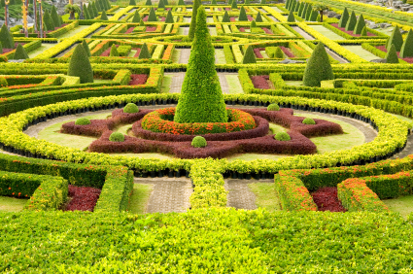
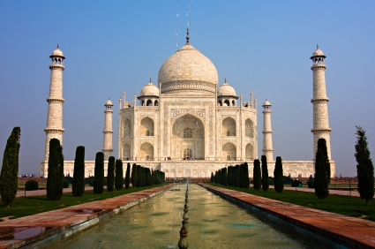
Symmetrical (Formal) Balance
The elements within the design are identical in visual weight in relation to a centerline or axis
©iStockphoto.com
©iStockphoto.com
The Taj Mahal Mausoleum
Agra, Uttar Pradesh, India
Microsoft Office clipart
Microsoft clipart
Notes:
In symmetrical balance, there is an equal distribution of visual elements within the image, although the visual elements do not necessarily need to be identical.
Taj Mahal Mausoleum was designed as a tomb by Emperor Shah Jahan for his young wife Mumatz Mahal. With the onion domes, it is a famous example of Islamic architecture.

Slide 26
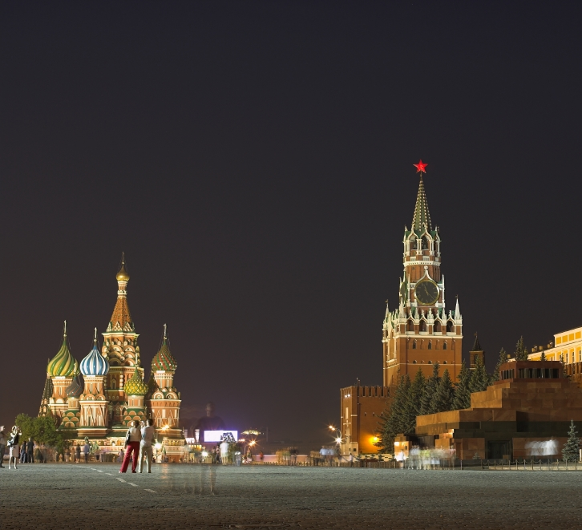
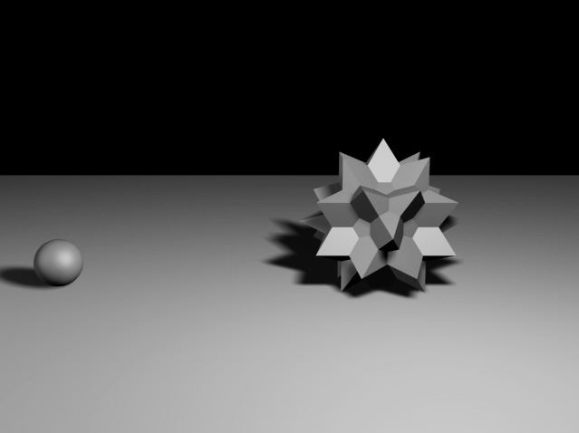
Asymmetrical (Informal) Balance
The elements within the design are not identical but are arranged to provide a balanced visual weight
Image courtesy Autodesk, Inc.
Microsoft Office clipart
Notes:
The image of Red Square in Moscow illustrates asymmetrical balance because the larger structure is closer to the center, while St Basil’s Cathedral in the background has a smaller visual weight and is farther from the center of the image.

Slide 27
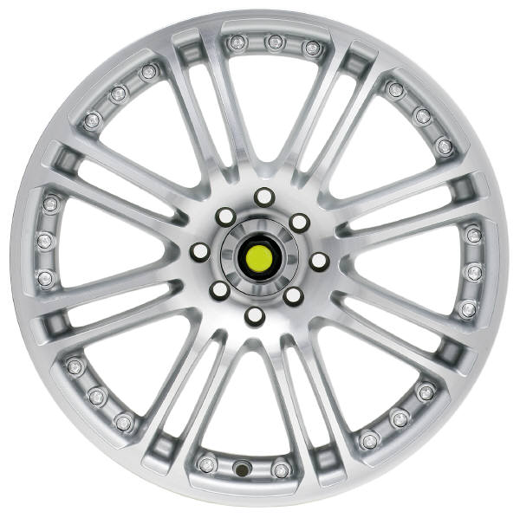
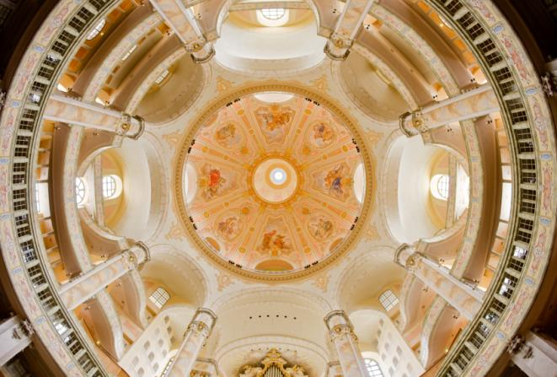
Radial Balance
Distribution of components in a circular pattern around a center point
Microsoft Office clipart
Dresden Frauenkirche
Dresden, Germay
Microsoft clipart

Slide 28
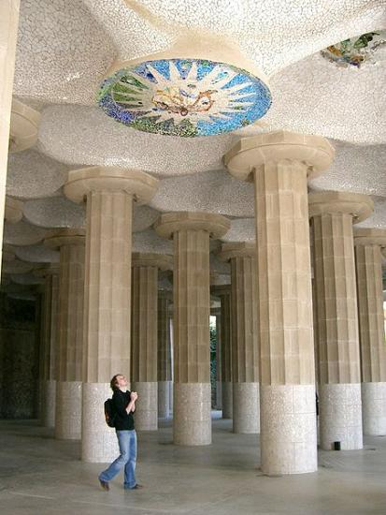
Emphasis
Used to draw attention to one area
Focal Point – feature in a design that attracts the eye
Can be achieved through
Size
Placement
Shape
Contrast
Use of lines
Wikipedia.org
Microsoft Office clipart
Notes:
What is the focal point in each composition? How is emphasis achieved?
In the left image, a ceiling mosaic in Park Gruell in Barcelona, Spain, the mosaic is emphasized through a contrast in color and texture. In the composition, the fact that the person is looking at the mosaic also causes a viewer to follow his line of sight.
In the right image, a contrast in value and shape attract the eye. The yellow lines of the tight rope also cause the eye to move toward the dark figure.

Slide 29
Emphasis
Microsoft clipart
©iStockphoto.com
Notes:
What is the focal point of this device? How is emphasis achieved? What is the purpose of the emphasis?

Slide 30
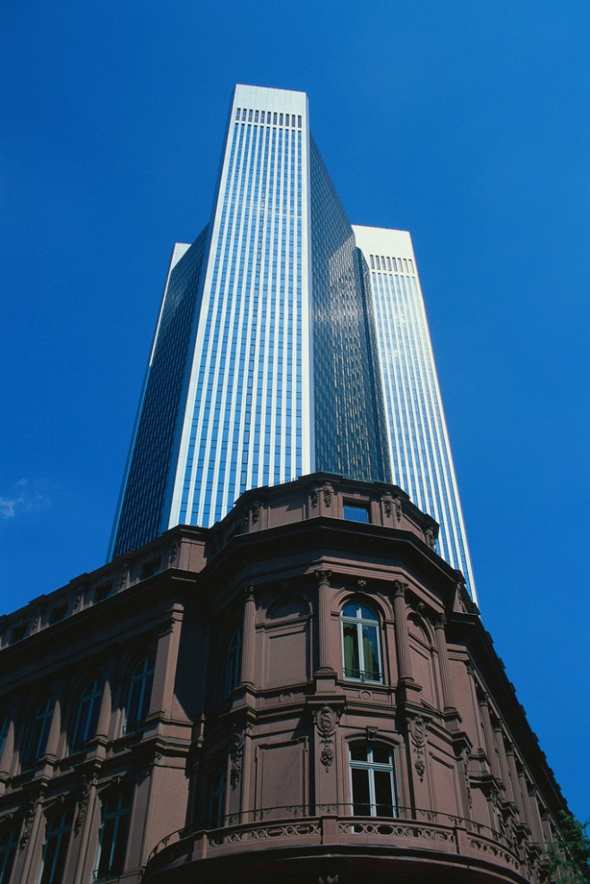
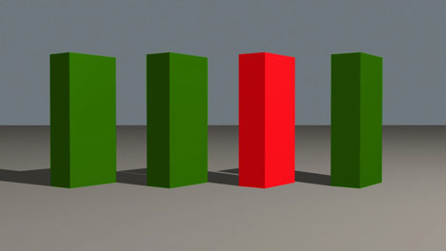
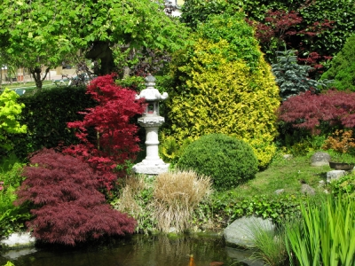
Contrast
Microsoft Office clipart
The degree of relative difference between elements
©iStockphoto.com
Image courtesy Autodesk, Inc.
Notes:
Describe the contrast in each image.
The image on the left shows contrast in color.
The image on the upper right shows contrast in value, texture, size, and style between the two buildings.
The image at the bottom shows contrast between natural and man-made objects as well as contrast in texture and color.

Slide 31
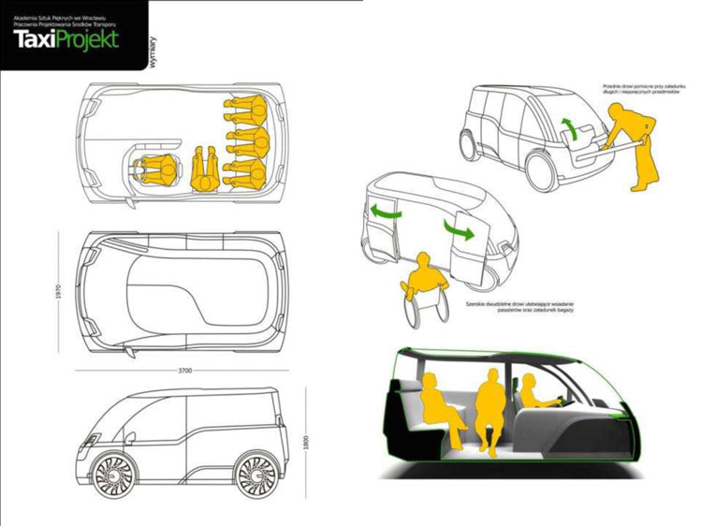
Contrast
Can be used to emphasize an element of a design
Image courtesy Autodesk, Inc.
Notes:
In the line drawings, the designer provides emphasis with fills of color on an otherwise neutral composition.

Slide 32
Rhythm
Repeated use of line, shape, color, texture or pattern
A harmonious pattern or sequence
Types
Regular
Random
Gradated
Graduated
Microsoft Office clipart

Slide 33
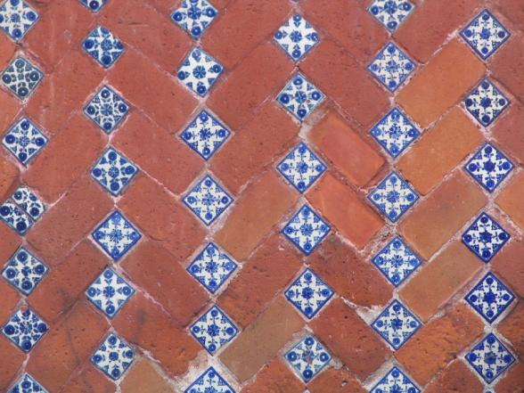
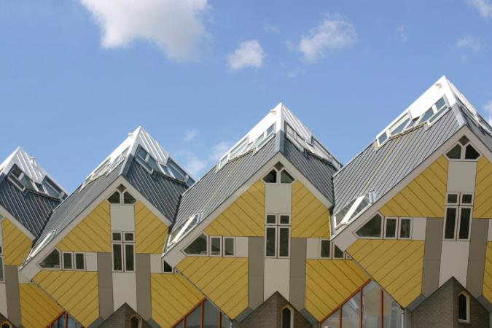
Regular Rhythm
An element is repeated at the same repetition/interval
Microsoft Office clipart
Microsoft Office clipart

Slide 34
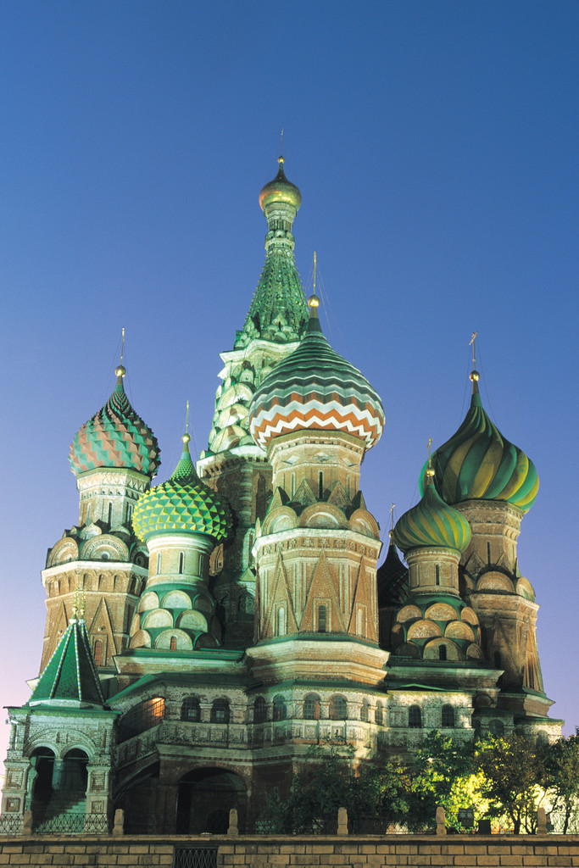
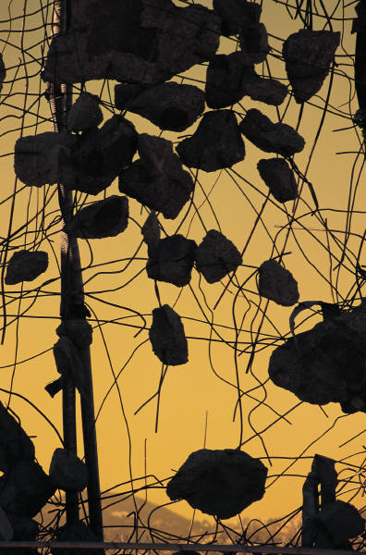
Random Rhythm
Microsoft Office clipart
The repetition of the element is random or situated at irregular intervals
Microsoft Office clipart
Notes:
The broken pieces of concrete caught in reinforcing steel display a random rhythm.
The repeated use of the onion domes creates a random rhythm in the design of Saint Basil’s Cathedral.

Slide 35
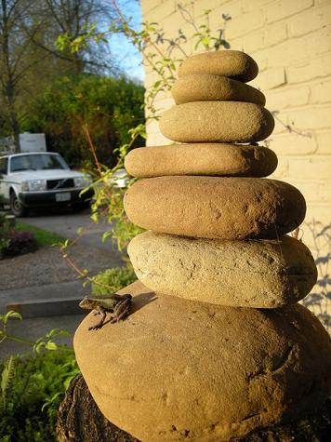
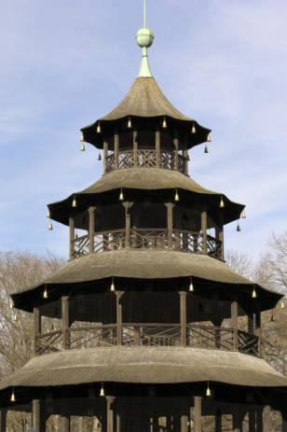
Gradated Rhythm
The repeated element is identical with the exception of one detail increasing or decreasing gradually with each repetition
Left: Stack of rocks used as focal point in landscaping
Right: The Chinese Tower English Gardens
Munich, Germany
www.wikimedia.org
Microsoft Office clipart
Microsoft Office clipart

Slide 36
Graduated Rhythm
The repeated element becomes closer or further apart
Microsoft Office clipart
Microsoft Office clipart
Notes:
What is the repeated elements here? How does this image display gradated rhythm?

Slide 37
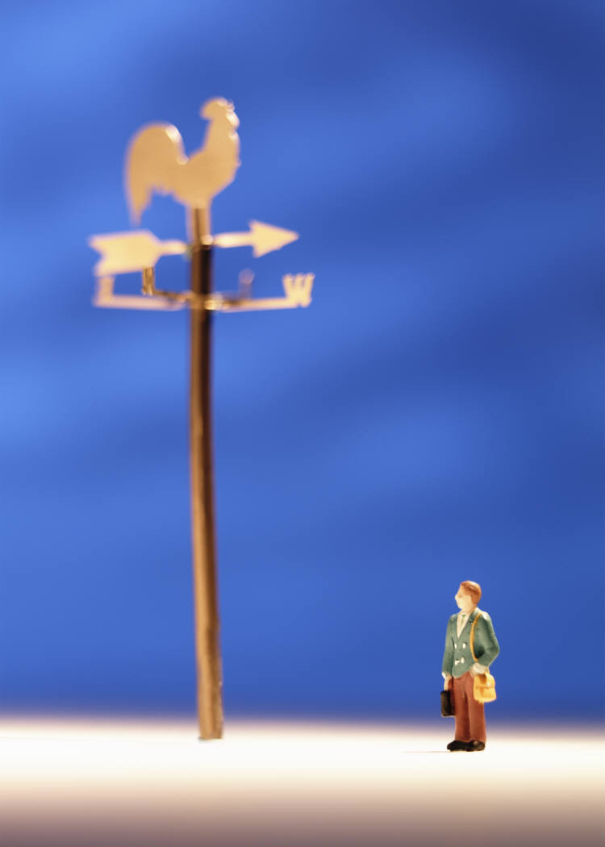
Proportion
Microsoft Office clipart
Comparative relationship between elements in a design with respect to size
Scale – The proportion or size of an element in relation to the other elements
Microsoft Office clipart
Microsoft Office clipart
Notes:
Because of its height, the Washington Monument is the most prominent structure in Washington, D.C., shown here with the Lincoln Memorial in the foreground and the U. S. Capitol building in the background. The monument is shaped like an Egyptian Obelisk and stands 555 ft - 5 1/8 in. tall.

Slide 38
Unity
The consistent use of design elements
©iStockphoto.com
Microsoft Office clipart
©iStockphoto.com
Notes:
Many colleges achieve a sense of unity throughout the campus by consistently using specific materials. West Virginia University in Morgantown uses red brick. Notice that the red brick used in the buildings is also used in the landscape walls in the foreground.
How is unity achieved in the landscape design? Repetition of the same color, the same plants, and curved paths.
Although the Russian dolls are individually created, the consistent use of size, shape, and color unify the designs.

Slide 39
Economy
Use of the bare minimum of elements
Can be achieved by removing extraneous elements
In simplicity there is beauty
Less is more
Image courtesy Autodesk, Inc.
Notes:
The principle of economy promotes simplification of the elements of design to express a message. Using extraneous elements in a design can be distracting and confusing for the user. If you can remove an element within a design, and the design still accomplishes the goals within the constraints, you have practiced economy of design.
Graphic signs provide good examples of economy because they often simplify a complex idea with only essential details.

Slide 40
Economy
Image courtesy Autodesk, Inc.
Image courtesy Autodesk, Inc.
Notes:
In the design process, many products include meticulous details. For instance, the design of a vehicle involves details on mechanics, electronics, ergonomics, visual appeal, materials, etc. Designers will focus on a basic element in the beginning stages of a design – a form of economy of design. Here you see concept sketches for the exterior shape of a vehicle.

Slide 41
Visual Design Principles and Elements Matrix
Notes:
A matrix can help you analyze the visual characteristics of an object and identify the use of the visual elements and principles of design. This example documents the visual elements and principles of design evident in a soap dish [click].
First, identify the elements of design [click]. For instance, the shapes used in this design are geometric, rectangular and circular. [click]
Once the elements of design are identified, you can determine how they demonstrate the principles of design. [click] [click]

